Slide 1
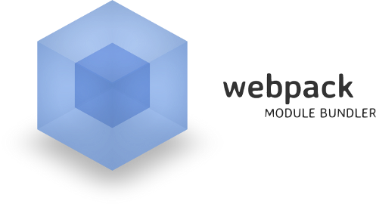
Project Architecture
Packages, Dependencies, Webpack
SoftUni Team
Technical Trainers
Software University
https://softuni.bg

Slide 2
Have a Question?
sli.do #js-advanced

Slide 3
Table of Contents
Packages
Dependencies
What is Webpack?
Basic Builds

Slide 4

Designing with Packages

Slide 5
Designing with Packages
Packages can be used as containers for a group of classes
By grouping classes into packages we can reason about the design at a higher level of abstraction
The relationships between packages expresses the high level organization of the application

Slide 6
Packages in JavaScript
In JavaScript, there's no documented concept for a package system
You can consider a directory as the package and a JavaScript file as the class
the package system is the File System and the classes are the files
In a JavaScript project, the File System is the Package System

Slide 7
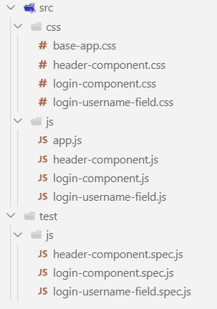
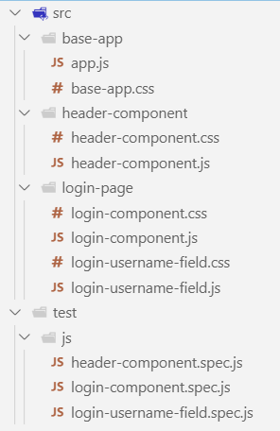
Designing with Packages Example
You'll never use the login-component.js and the header-component.js files together
Their functionality will never be used simultaneously for the same purpose
They should exist in separate packages

Slide 8

Dependencies

Slide 9
Dependency Structure
Dependency - when a piece of software relies on another one
A good dependency should be upon something that is unlikely to change
Your components should depend on each other to the least extent practicable (loose coupling)
There must be no cycles in the dependency structure

Slide 10
Effects of a Cycle
Makes it very difficult to isolate modules
Unit testing and releasing become very difficult and error prone
Compile times grow geometrically with the number of modules
A
B
C
D
E

Slide 11
Stability and Dependency
Stability is a measure of the difficulty in changing a module
A package structure should be designed so that some packages are instable and some are stable
A package should only depend upon packages that are more stable than it is
Packages that are maximally stable should be maximally abstract

Slide 12

A Wicked Smart Module Bundler
Webpack

Slide 13



What is Webpack?
One of the newest tools, combining build steps and bundling
Bundles JavaScript files for usage in a browser
Supports dependency management
Can load any 3rd party library as a module
Comes with it's own development server
JS
JS
JS
JS
Bundle
CSS
CSS
CSS
CSS

Slide 14
What Does Webpack Do?
Manages dependencies
require
import
Build tasks - convert and preprocess
Minify
Combine
Sass / Less conversion
Babel transpile
Combines the build system and module bundling

Slide 15
Code Splitting
All in one request
+ Less latency
- Get all bunch
Request per module
+ Get only what you need
Much overhead
Requests latency
Modules to chunks
+ Get only what you need
+ Less requests,
less overhead

Slide 16

Webpack Build Process
JS
JS
JS modules with dependencies
JS
JS
JS
Stylesheets
Bundle
Deployment
CSS
CSS
CSS
Images and other assets

Slide 17

Webpack Installation

Slide 18
Installation and CLI
Install Webpack via npm
Install the Webpack command line interface
Install the add-on development server
npm install webpack --save-dev
npm install webpack-cli --save-dev
npm install webpack-dev-server --save-dev

Slide 19
Package.json
Change package.json file
{
"name": "Demo",
"version": "1.0.0",
"description": "",
"private": true,
"main": "index.js",
"scripts": {
"test": "echo \"Error: no test specified\" && exit 1"
},
"keywords": [],
"author": "",
"license": "ISC",
"devDependencies": {
"webpack": "^4.35.3",
"webpack-cli": "^3.3.5",
"webpack-dev-server": "^3.7.2"
}

Slide 20
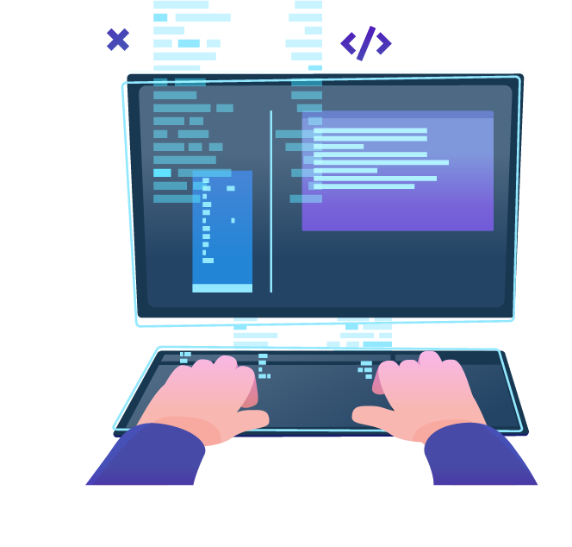
Config File, Watch Mode, Production
Basic Builds

Slide 21
Modules
The import and export statements have been standardized in ES2015. They are not supported in most browsers yet
Behind the scenes, webpack actually "transpiles" the code so that older browsers can also run it
Note that webpack will not alter any code other than import and export statements

Slide 22
Adding a Config File
Create a webpack.config.js to automate your build
Configuration is in JSON format
When running npx webpack from the terminal, it uses this config
module.exports = {
entry: "./app.js",
output: {
filename: "bundle.js",
path: path.resolve(__dirname,'dist')
}
};
Starting module
Final output file
Destination path

Slide 23
Enable Watch Mode
Webpack can watch for file changes and rebuild the bundle
Add an argument or change your config file to enable hot reloading
npx webpack --watch
module.exports = {
entry: … ,
output: … ,
watch: true
};

Slide 24
Web Server with Watch Mode
Run the development server from the terminal
Change your config file to enable hot reloading
npx webpack -dev-server --open
module.exports = {
entry: … ,
output: … ,
devServer: {
publicPath: "/dist/",
watchContentBase: true,
}
};

Slide 25
Building Multiple Files
Requiring files
Adding an additional entry file to our webpack.config.js file
require("./file")
module.exports = {
entry: ["./global.js", "./app.js"],
output: {
filename: "bundle.js"
}
};

Slide 26
Processing Files with Loaders
Loaders apply transformations to files
Can be downloaded with npm and configured in the main config
Preloaders are the same, they just run before any loaders
module.exports = {
entry: "./entry.js",
output: {filename: "bundle.js"},
module: {
rules: [ … ]
}
};
Loader format
{
test: /\.css$/,
exclude: /node_modules/,
loader: "style-loader"
}

Slide 27
Creating a Start Script
Webpack uses npm scripts for further automation
Add to your package.json file
Instead of running npx webpack-dev-server, we can run the following instead
scripts: {
"start": "webpack-dev-server --open"
};
npm start

Slide 28
Production and Development Builds (1)
To minify the bundle for deploy, run webpack with –p argument
Install strip-loader
Strips arbitrary functions out of your production code
Create webpack-production.config.js
You can specify a different config file for production
npx webpack -p
npm install strip-loader --save-dev
npx webpack --config webpack-production.config.js -p

Slide 29
Production and Development Builds (2)
In the webpack-production.config.js write the following code:
Require the strip-loader npm module
Require the original webpack configuration file
let WebpackStripLoader = require('strip-loader');
let devConfig = require('./webpack.config.js');

Slide 30
Production and Development Builds (3)
Create a new object, and pass in the test, exclude and loader keys
let stripLoader = {
test: [/\.js$/, /\.es6$/],
exclude: /node_modules/,
loader: WebpackStripLoader.loader('console.log')
}

Slide 31
Production and Development Builds (4)
Push the new object into our loaders array from our original config
Export our new config object
devConfig.module.loaders.push(stripLoader);
module.exports = devConfig;

Slide 32

Live Exercise in Class
Practice

Slide 33

Summary
Arrow functions ≈ short function syntax
Webpack is a module bundler. It relies on:
Dependency graph underneath
Loaders and plugins
Its configuration describes how to transform assets of the graphs
Features like code splitting are used
It comes with it's own development server

Slide 34
Questions?
Notes:
34

Slide 35











SoftUni Diamond Partners

Slide 36



Educational Partners

Slide 37
Trainings @ Software University (SoftUni)
Software University – High-Quality Education, Profession and Job for Software Developers
softuni.bg, about.softuni.bg
Software University Foundation
softuni.foundation
Software University @ Facebook
facebook.com/SoftwareUniversity
Software University Forums
forum.softuni.bg
Notes:
37

Slide 38

License
This course (slides, examples, demos, exercises, homework, documents, videos and other assets) is copyrighted content
Unauthorized copy, reproduction or use is illegal
© SoftUni – https://about.softuni.bg/
© Software University – https://softuni.bg
Notes:
38

